Slide 1

MENTAL HEALTH AI CHATBOT
N.Sanjay 2303A51LA4
Ch.Jignesh shourya 2303A51L90
D.Abhiram 2303A51L65
M.Akhil 2303A51L38
A.Mahesh Babu 2303A51LA5
.

Slide 2
PROBLEM STATEMENT
Many people experience sudden health symptoms but cannot immediately understand what condition they might have or which doctor to consult. In real-time situations, they rely on guesswork or the internet, which often leads to confusion or wrong self-treatment. There is a need for an instant, reliable system that can interpret symptoms, predict possible diseases, and provide remedies, medicines, and doctor recommendations on the spot. This project aims to deliver that real-time health assistance using AI and NLP.

Slide 3
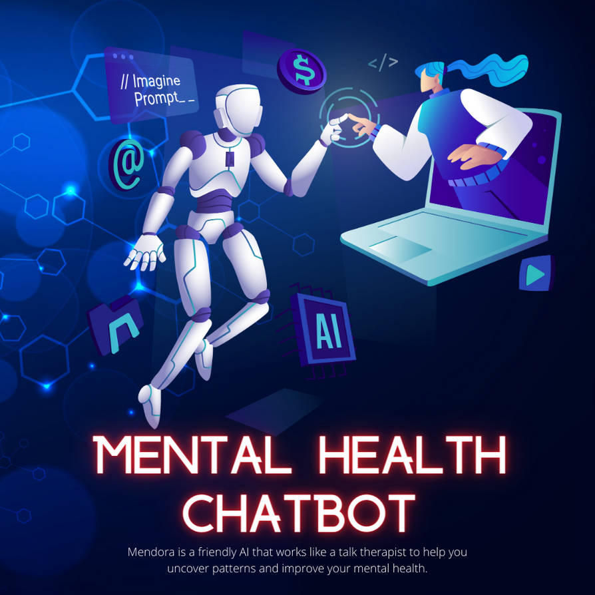
INTRODUCTION
Mental health issues are increasing globally.
Early guidance and emotional support are crucial.
Chatbots offer anonymous, accessible, and instant help.
This project aims to build an AI-powered supportive chatbot.
.

Slide 4
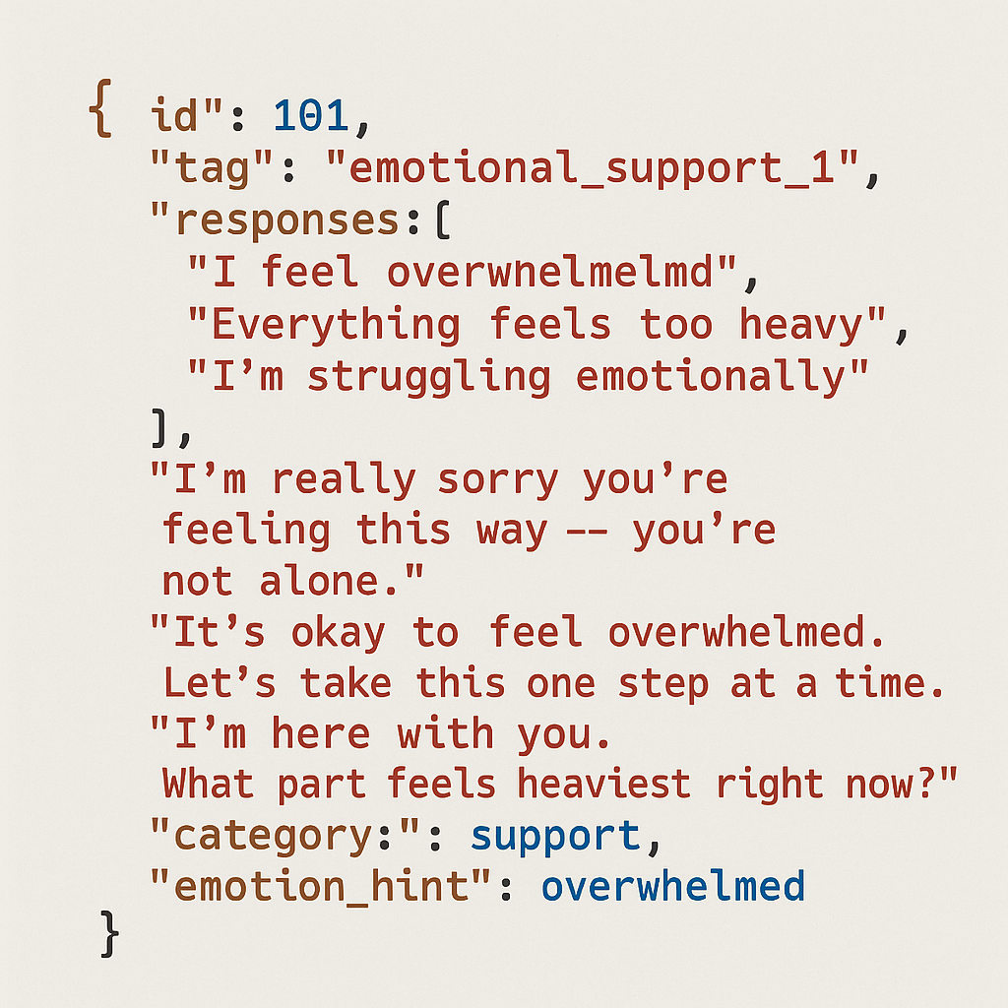
DATASETS USED
Custom Intent Dataset for mental health patterns & responses.
Emotion Classification Dataset for detecting sadness, stress, anxiety, etc.
Pre-trained LLM / NLP dataset via Cohere API.
.

Slide 5
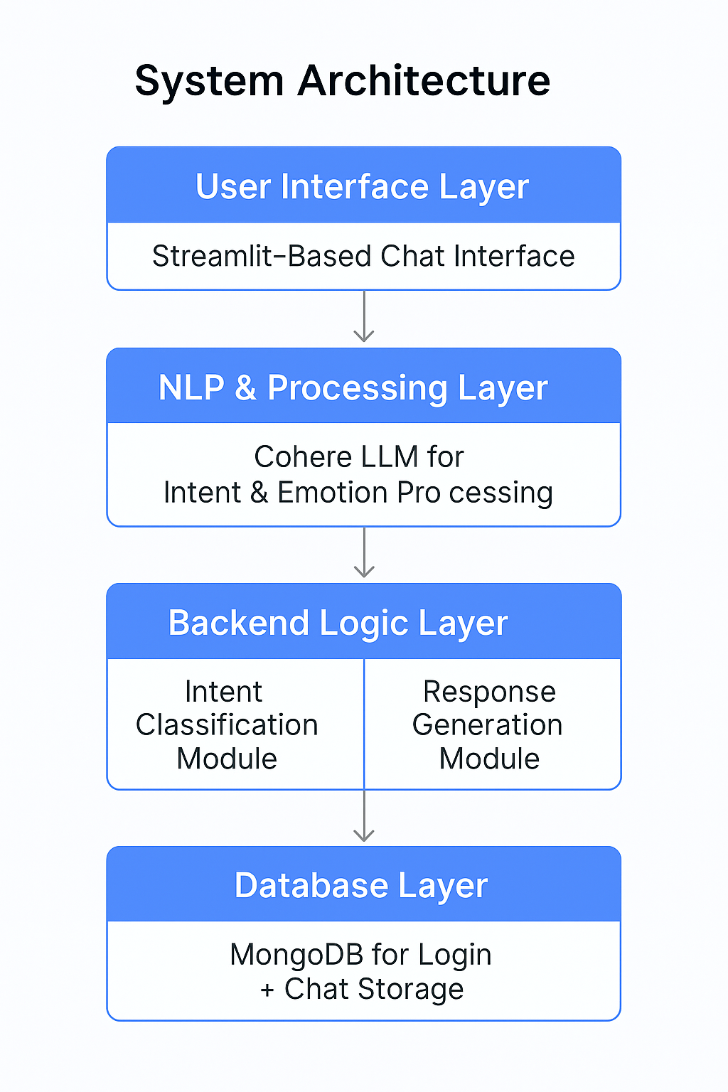
SYSTEM ARCHITECTURE
UI Layer: Streamlit-based chat interface.
NLP Layer: Cohere LLM for intent & emotion processing.
Logic Layer: Intent classification & response module.
Database Layer: MongoDB for login + chat storage.

Slide 6
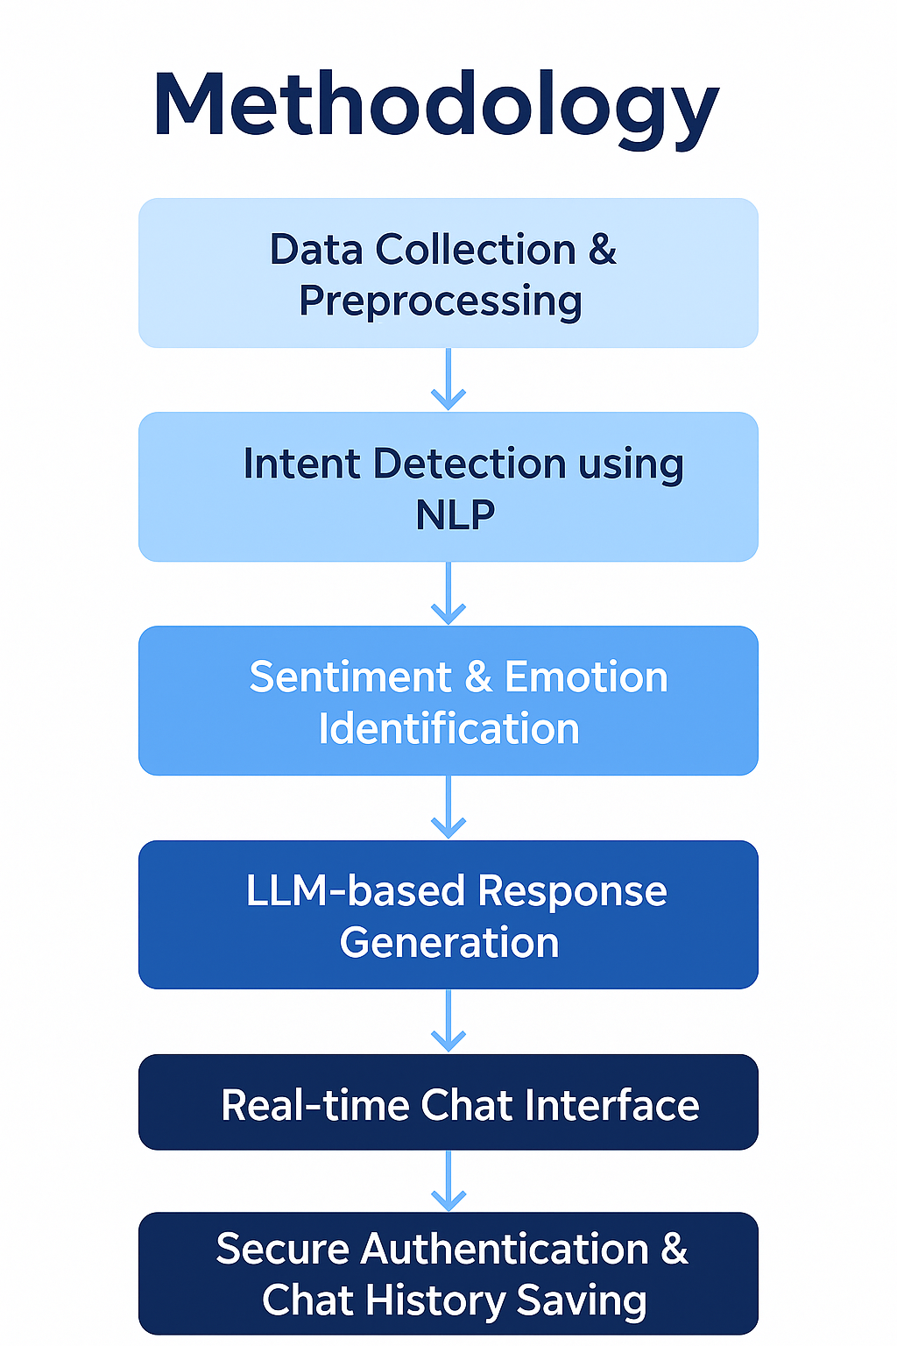
METHODOLOGY
Step 1:
Data collection & preprocessing.
Step 2:
NLP-driven intent & emotion detection.
Step 3:
LLM-based response generation.
Step 4:
Deployment with secure authentication & chat history.

Slide 7
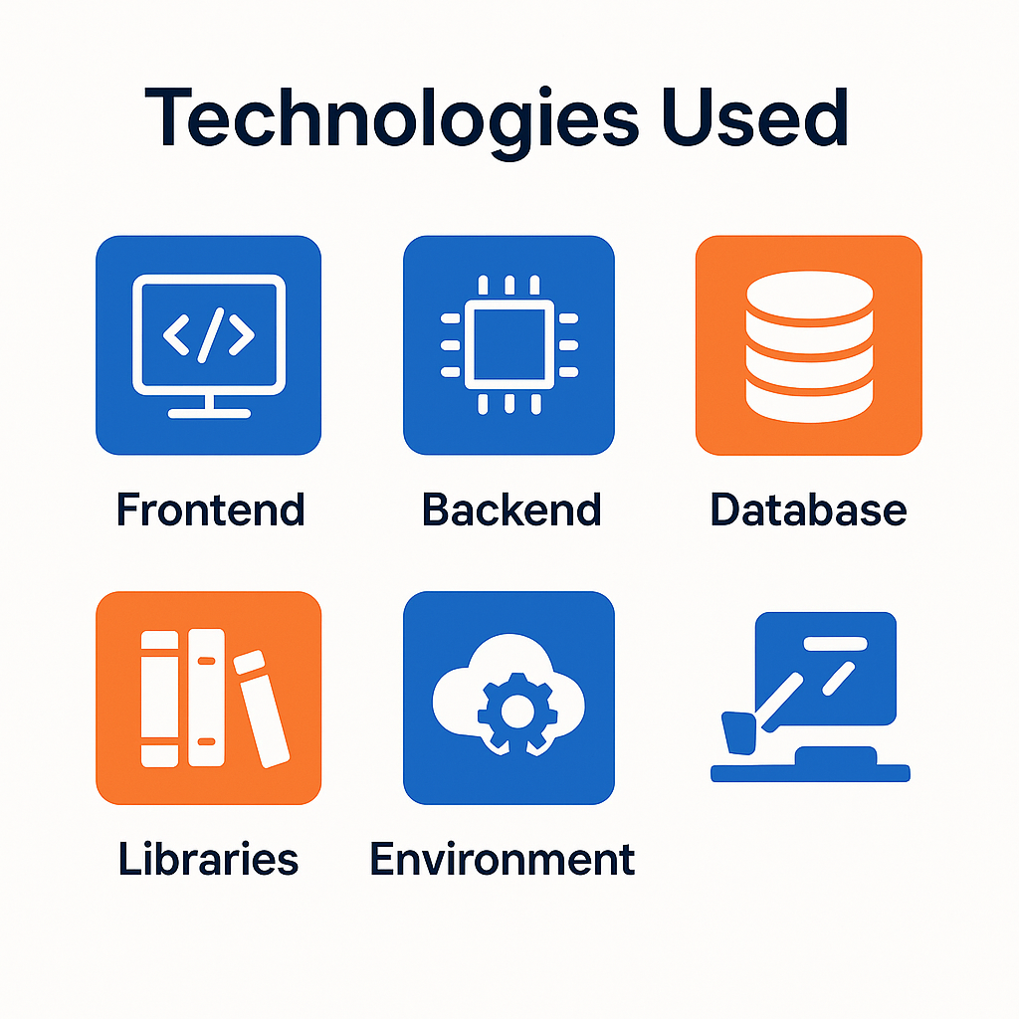
TECHNOLOGIES USED
Frontend: Streamlit Web App for real-time chat interface.
Backend: Python, Cohere LLM for NLP + response generation.
Database: MongoDB for user login, authentication, and chat history storage.
Libraries: bcrypt (password hashing), JSON, threading, datetime, etc.
Environment: Cloud-based API integration and secure deployment.

Slide 8
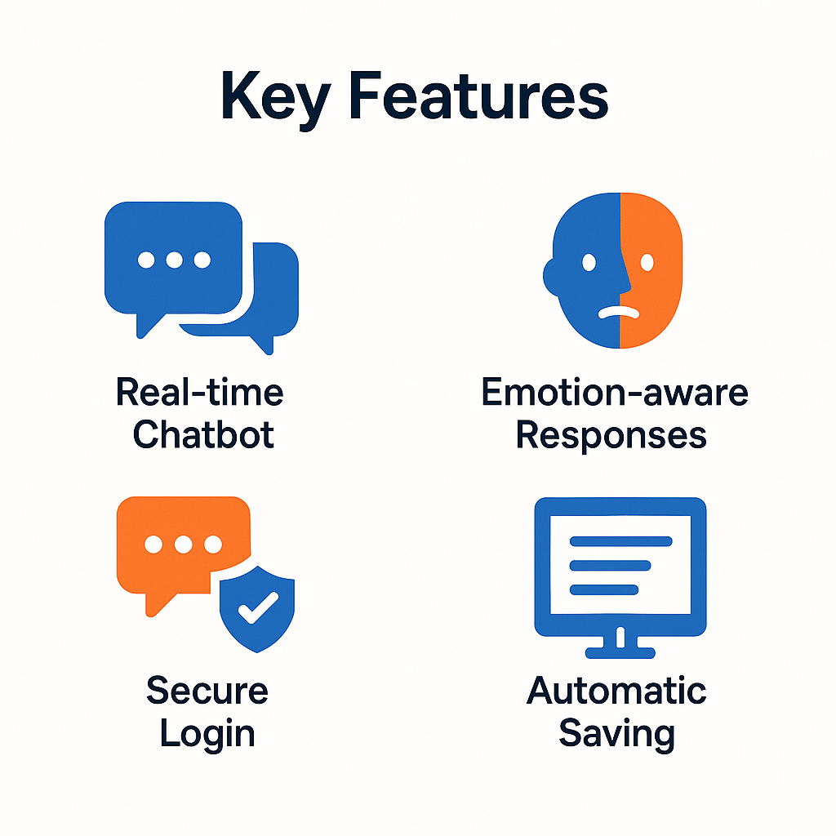
KEY FEATURES
Real-time empathetic chatbot for mental wellness support.
Emotion-aware and intent-sensitive responses.
Clean chat UI with typing animations and timestamp display.
Secure login system with hashed passwords.
Automatic chat history saving and viewing.
Anonymous, accessible, and user-friendly interface.

Slide 9
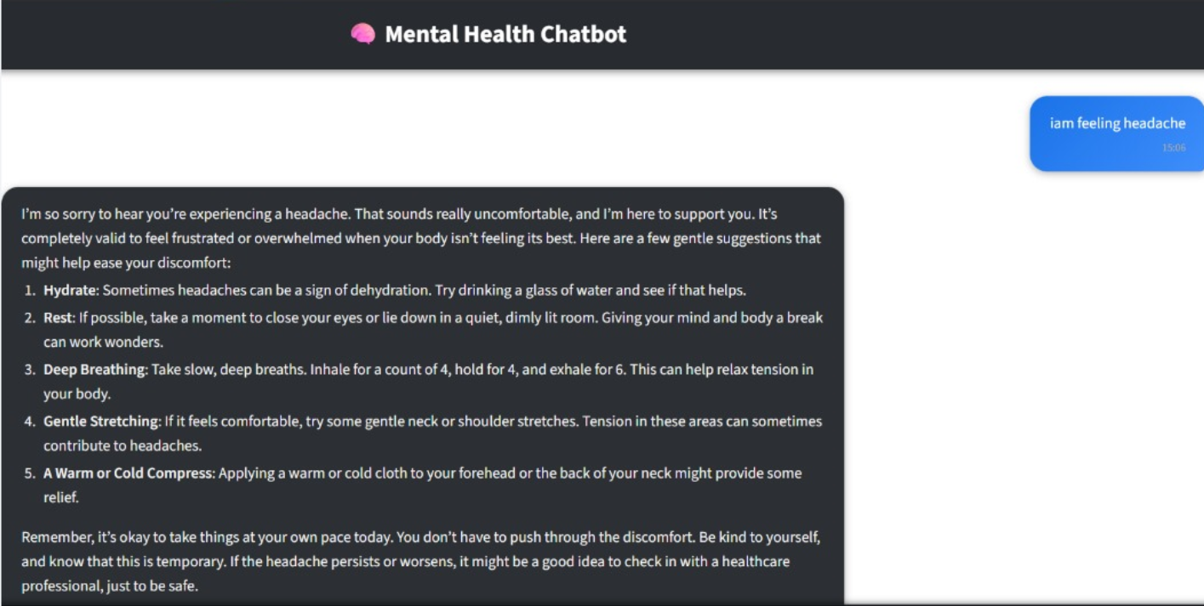
RESULTS & KEY FINDINGS
The chatbot successfully identifies emotional states with high precision.
Generates supportive and context-aware responses in <1 second.
Users found the interface intuitive and comforting.
Secure authentication increased user trust and safety.
Improved emotional coverage through custom datasets.

Slide 10
FUTURE SCOPE
Voice input & speech-based emotional detection.
Multilingual chatbot support.
Integration with mobile app or WhatsApp.
Real therapist escalation support.
Enhanced analytics for mental health trends.
Google based authentication for user

Slide 11
CONCLUSION
The mental health chatbot effectively provides supportive and empathetic responses using NLP and LLM technology.
It accurately detects user intent and emotional state to deliver personalized guidance.
The system's secure architecture ensures safe login and reliable conversation storage.
Real-time interaction and a simple interface enhance user comfort and accessibility.
Overall, the chatbot demonstrates strong potential as a digital mental wellness companion.

Slide 12
THANK YOU

